Slide 1
NBAC TSC Governance Doc, Lightweight Rules, CLAs, Resources
31 August 2023
Kamran Atri (NBAC TSC Co-Chair)
Thomas Krul (NBAC TSC Co-Chair)

Slide 2
AGENDA
1:00 NBAC Co-Chair Opening Remarks – Mr. Kamran Atri, Mr. Thomas Krul
1:10 Domain Space Sub-Committee/ COI Updates – Around the Horn Collaboration
Member Questions
1:15 OASIS Policy/Procedures Discussion for a solution for occasional content contributors - Chet Ensign
1:25 NIEM Management Office (NMO) Update – Ms. Katherine Escobar
1:30 NIEM 6.0 Planning & Harmonization – Ms. Christina Medlin
1:35 NTAC Update – Dr. Scott Renner, Jim Cabral, & Mr. Tom Carlson
1:40 Communications & Outreach NMO Sub-Committee update – Paul Wormeli
1:45 Questions
1:50 Final Remarks

Slide 3
Co-Chair Remarks
A reminder that each Domain Space Sub-Committee needs to complete individual and entity clas if not already executed. https://www.oasis-open.org/policies-guidelines/open-projects-process/#CLAs-license-notices
Sub-Committees submitting content for Version 6.0 must have I and e clas executed.
The updated and approved MilOps Sub-Committee Governance Document is posted to the MilOps folder on the NBAC Admin Repo.
https://github.com/niemopen/nbac-admin/blob/main/milops-subcommittee/(FINAL)%20MILOPS%20Sub-Committee%20Governance%20Doc%20v6%20%207-13-2023.pdf
The updated & PGB approved NBAC TSC Governance Document is posted to the documents folder on the NBAC Admin Repo. https://github.com/niemopen/nbac-admin/blob/main/documents/(APPROVED)%20%20NIEMOpen%20NBAC%20TSC%20Governance%20Doc%20(Rev%202)%20%20v7%20%207-27-2023.pdf
NIEM Training migrating to NMO TSC Repo. POC Tom Carlson. https://github.com/niemopen/nmo-training
Learning Management System (LMS) Procurement Approved. PROCURED
Updated rosters. https://github.com/niemopen/nbac-admin/tree/main/roster

Slide 4
Contributor License Agreements
Contributors
4.1 Any person (whether or not an OASIS member) may participate in a Project as a Contributor by providing comments or bug reports to a Project Repository, subject to the licensing rules in Sections 14, 15 and 16 …
4.2 Any person … may agree to a Contributor License Agreement (CLA), as provided in the licensing rules … as a prerequisite for acceptance of their pull requests or other substantive contributions.
If a person who signs and submits an individual CLA indicates that they represent an entity, then that individual CLA will only be deemed effective if that entity has signed and submitted an entity CLA.
The Project Governing Board and Maintainers shall only act on pull requests or other substantive contributions made by project Contributors who are listed in the OASIS system as having agreed to the relevant CLA.
OASIS is currently working on a procedure via OASIS email to contribute without the current CLA - will keep you posted

Slide 5
Contributor License Agreements (CONT.)
Who Needs a CLA?
How to register a CLA?
Contributors
PGB Members
Maintainers
TSC Members
Sub-Committee Members
Tiger Team Members
Appendix A-1: Individual CLA
OASIS Open Projects: Individual Contributor License Agreement (CLA)
The text and links to file i-CLAs for Open Projects are available at https://www.oasis-open.org/open-projects/cla/oasis-open-projects-individual-contributor-license-agreement-i-cla/ .
Appendix A-2: Entity CLA
OASIS Open Projects: Entity Contributor License Agreement (CLA)
The text and link to file an e-CLA for an Open Project is available at https://www.oasis-open.org/open-projects/cla/entity-cla-20210630/.
You will need a GitHub Account to Register a CLA:
Join GitHub · GitHub
Can register by pdf as alternative

Slide 6
NBAC TSC Governance
NBAC TSC Admin Repo: https://github.com/niemopen/nbac-admin
NBAC TSC Governance Doc: https://github.com/niemopen/nbac-admin/blob/main/documents/(APPROVED)%20%20NIEMOpen%20NBAC%20TSC%20Governance%20Doc%20(Rev%202)%20%20v7%20%207-27-2023.pdf
NBAC TSC Scope
Composition
NBAC Chair/Co-Chair
NIEMOpen Domain Space Sub-Committees
Harmonization Sub-Committee
Contributing to NIEMOpen
Voting & At Large TSC Members
PGB Voting & Non-Voting Members
NBAC TSC Maintainers
Responsibilities
NBAC TSC Meetings
Decisions
Appeals
Instantiating a Sub-Committee
Conservatorship
Sub-Committee Nomination_Onboarding_Instantiation
https://github.com/niemopen/nbac-admin/blob/main/sub-committee-documents/(FINAL)%20Sub-Committee%20Nomination_Onboarding_Instantiation%20v4%206-5-2023.pdf

Slide 7
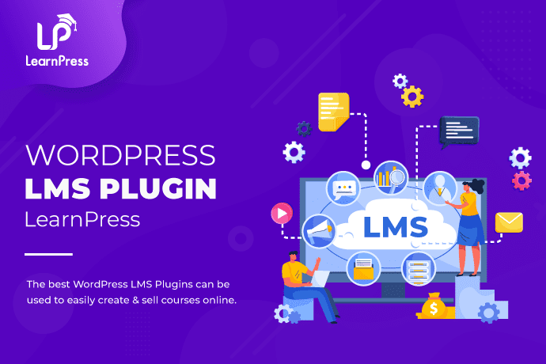
LearnPress LEARNING MANAGEMENT SYSTEM (LMS)
Incorporate online training directly into NIEMOpen.org; establish modularized dynamic content to reduce learning curve of IEPD/MEP design, development, and implementation
Estimate: $2,000 / per annum
Was on sale so purchased at a better price-point ~$300
COTS software; 1-year license; does not include cost to produce content
Notes:
Incorporate engagement to test user understanding of key concepts;
Provide certificate of completion; explore paid training model
Impact:
Contribute IEPD/MEP for engagement and re-use, COTS service leverages built-in publicly accessible API for metadata

Slide 8








resources
Follow Us On Twitter
https://twitter.com/NIEMconnects?ref_src=twsrc%5Etfw
Katherine Escobar, katherine.b.escobar.civ@mail.mil, 7575-203-8631
Beth Smalley, beth.l.smalley.civ@mail.mil, 757-203-7177
https://www.niem.gov/
https://niemopen.org/
https://www.linkedin.com/groups/1903175/profile
Git Repos
NIEMOpen: https://github.com/niemopen/
NTAC TSC
https://github.com/niemopen/ntac-admin
NBAC TSC
https://github.com/niemopen/nbac-admin
NMO TSC
https://github.com/niemopen/nmo-admin
NIEMOpen Slack Channel: https://niemopen.slack.com/
Mailing Lists
NIEMOpen: https://lists.oasis-open-projects.org/g/niemopen
PGB: https://lists.oasis-open-projects.org/g/niemopen-pgb
NTAC TSC: https://lists.oasis-open-projects.org/g/niemopen-ntactsc
NBAC TSC: https://lists.oasis-open-projects.org/g/niemopen-nbactsc
NMO TSC: https://lists.oasis-open-projects.org/g/niemopen-nmotsc
https://www.youtube.com/channel/UCg9qV22PXLBjG41hc-EwVrQ
Message Exchange Package (MEP Registry & Repository
Restricted Repository-WMAAFIP
NIEM Message Exchange Package Builder

Slide 9
OASIS Lightweight Rules
Table of Contents w/Links
1. Purpose of Open Projects
2. Project Formation
3. Roles of Parties in the Project
4. Contributors
5. Project Governing Board and Project Sponsors
6. Technical Steering Committees
7. Project Chairs, Maintainers, and Technical Steering Committees
8. Repositories and Project Tools
9. Visibility and Archival Permanence
10. Project Governance: Decisions and Meetings
11. Progression of Project Work
12. Releases and Group Releases
13. Project Specifications
14. OASIS Standard Approval and External Submissions
15. Repository and Specification Licenses
16. Trademarks
17. CLAs and License Notices
18. Appeals and Application of Rules
Appendix A-1: Individual CLA
Appendix A-2: Entity CLA
Notes:
Chair introduces Cathie Mayo

Slide 10


Questions
Do any of the members have any questions?

